Slide 1

Recommendation Movie System

Slide 2
Team
Khaled Waheed
Omar Araft
Mohamed Amr
Mahmoud Osama
Mohamed Wael
Ziad Soliman

Slide 3
Introduction
The Internet has experienced rapid growth since its invention, leading to an overwhelming amount of online information that poses challenges in quick and easy access.
Recommendation systems offer a solution to this problem, widely used in various industries like e-commerce, banking, and entertainment. These systems leverage user data to generate personalized recommendations.
Movie popularity is influenced by reviews, and users are more likely to choose movies preferred by others. Sentiment Analysis addresses the challenge of decision-making by classifying reviews as positive or negative.

Slide 4
Introduction
Sentiment Analysis involves using Natural Language Processing (NLP) to extract information from textual sources and classify statements as positive or negative, aiding in understanding the author's opinion and indicating user experience.
The paper introduces a system that not only recommends movies but also analyzes and classifies reviews into positive or negative categories. Cosine Similarity is used for movie recommendation, and Sentiment Analysis is performed using Support Vector Machine (SVM) and Naïve Bayes (NB) algorithms.
The study's objectives include dealing with large volumes of data, filtering useful information, recommending similar movies based on user choices, and performing Sentiment Analysis on selected movie reviews.

Slide 5
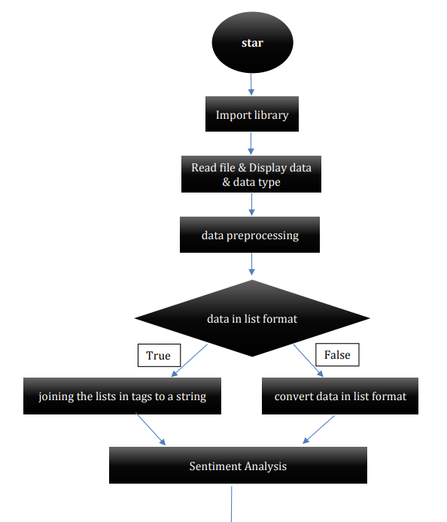

Slide 6
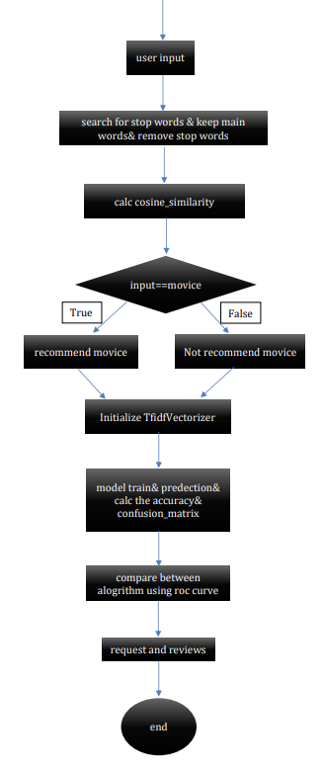

Slide 7
Fundamental libraries
1. NumPy (np): Used for linear algebra operations and working with lists and arrays.
import numpy as np
2. Pandas (pd): For data processing, often used with CSV or other structured data formats.
import pandas as pd
3. Matplotlib (plt) and Seaborn (sns): Visualization libraries.
import matplotlib.pyplot as plt
import seaborn as sns

Slide 8
4. NLTK (nltk) and Stopwords: NLTK is a library for NLP (natural language processing), with stopwords used to filter out common words in text data (e.g., "the", "and").
import nltk #Used for NLP
from nltk.corpus import stopwords #MLP
5. TfidfVectorizer: Converts a collection of raw text into a matrix of TF-IDF features (used for text classification).
from sklearn.feature_extraction.text import TfidfVectorizer #list to vector
6. Train Test Split (train_test_split): Utility function from scikit-learn to split data into training and testing sets.
rom sklearn.model_selection import train_test_split

Slide 9
7. Metrics: Accuracy, F1 score, precision, recall, confusion matrix, AUC (area under the curve) are used to evaluate model performance.
from sklearn.metrics import accuracy_score, f1_score, precision_score, recall_score, classification_report, confusion_matrix,auc
8. Pickle: To save and load Python objects (models, data) for later use.
import pickle

Slide 10
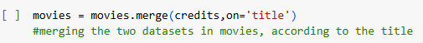
Preprocessing
1. Loading data:
movies = pd.read_csv('tmdb_5000_movies.csv')
credits = pd.read_csv('tmdb_5000_credits.csv’)
2. Data Merging and Selection:
• Merge the movies and credits DataFrames using the title column as the key.
• Select specific columns deemed essential for recommendations, such as movie_id, title, overview, genres, keywords, cast, and crew.

Slide 11
3. Data Cleaning and Transformation:
• Remove rows with missing values (NaN) to ensure data quality.
• Use the ast.literal_eval function: to convert string representations of lists and dictionaries into their actual data structures. This is particularly useful for columns like genres, keywords, cast, and crew, which contain nested information.

Slide 12
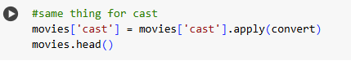
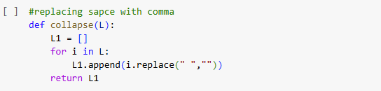
• Extract relevant information from the nested data structures. For example, the cast lists is limited to the top 3 actors and only the director is extracted from the crew information.
• Remove whitespaces from list elements to ensure consistency and prevent issues during further processing. This is achieved using the collapse function, which replaces spaces with empty strings within list elements.

Slide 13
4. Feature Engineering:
• Convert the overview column into a list of words using the split method. This allows for individual word analysis and representation.
• Create a new column called tags by combining the information from overview, genres, keywords, cast, and crew. This column serves as a comprehensive representation of the movie's characteristics.

Slide 14
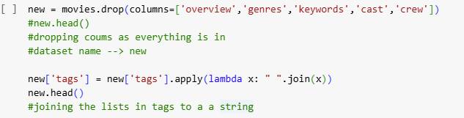
• Join the elements of the tags column into a single string, using spaces as delimiters. This creates a unified text representation for each movie.

Slide 15
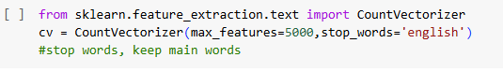
5. Text Vectorization: is the process of converting text data into numerical vectors. This is necessary because machine learning algorithms typically work with numerical data. By representing text as vectors, we can apply various mathematical operations and techniques to analyze and understand the text.
• Utilize the CountVectorizer from scikit-learn to convert the text data in the tags column into numerical vectors. This process involves creating a vocabulary of unique words and representing each movie as a vector of word counts.
• Limit the number of features (words) considered to 5000 and remove common English stop words to reduce dimensionality and focus on meaningful terms.

Slide 16
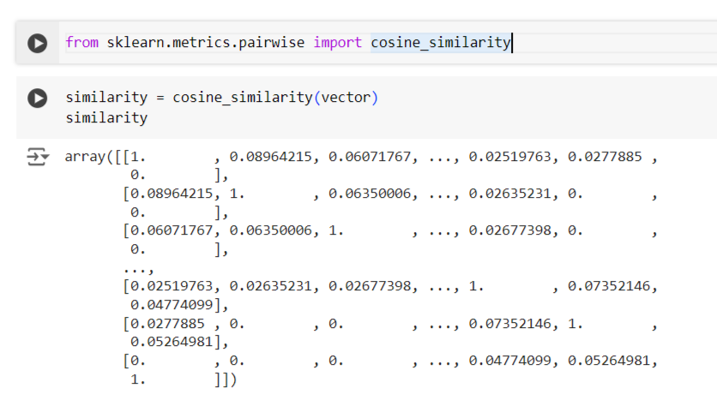
Cosine Similarity Computation:
• This metric is used to measure the similarity between two vectors by calculating the cosine of the angle between them.
• Cosine similarity is particularly useful when working with high dimensional data (like movie features) and is widely used in recommendation systems.

Slide 17
• Similarity = cosine_similarity(vector): The function returns a similarity matrix, where each element similarity[i][j] represents the cosine similarity between movie i and movie j. The diagonal elements (where i=j) will always be 1, as a movie is perfectly similar to itself.
• vector: This is a matrix where each row represents a movie and its associated features. For example, each row could encode information about genres, actors, directors, etc.

Slide 18
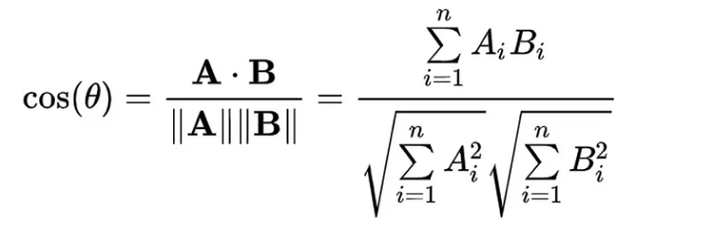
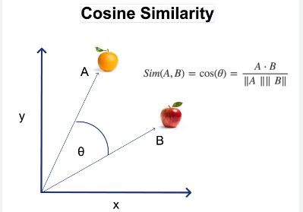

Slide 19
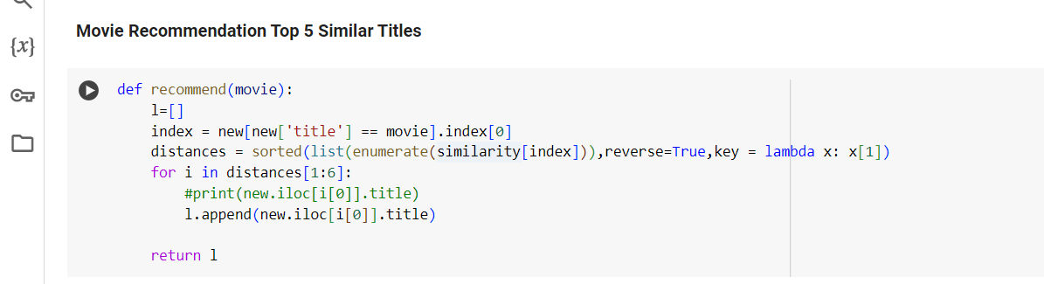
Movie Recommendation:
• This function recommends similar movies based on the similarity matrix.
• The function takes the title of a movie as input, for which we want to find similar movies.

Slide 20
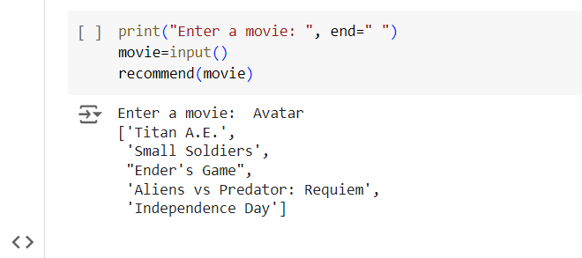
User Interface:
• The entered movie name is passed as an argument to the recommend() function, which then returns a list of 5 similar movie titles.

Slide 21
Sentiment Analysis:
Objective: To analyze the sentiment of movie reviews using machine learning techniques, aiming to understand how viewers feel about different films. This analysis provides valuable insights into audience opinions, which can be used to improve recommendation accuracy by incorporating not just quantitative data but qualitative user feedback.
Methods Used:
• Utilized techniques like tokenization, removal of stop words, and feature extraction using TF-IDF (Term Frequency-Inverse Document Frequency), which helps capture the importance of words within the reviews.
• Model Training with Naive Bayes and SVC.
• Evaluation and Comparison of Model Performance.

Slide 22
Preprocessing
We use:
1. Natural Language Toolkit (NLTK):
1. NLTK is used for pre-processing in sentiment analysis to eliminate such words as they carry very little useful information.
2. Stop words (common words like 'a', 'an', 'the', etc.) are removed using NLTK.
2. TfidfVectorizer:
1. Using TfidfVectorizer, the 'comments' column is tokenized.

Slide 23
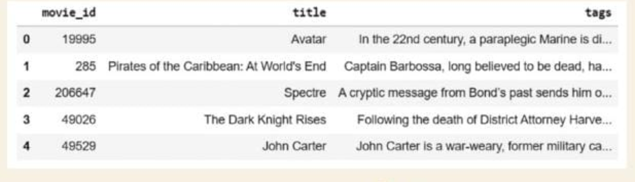
Pre-processing: The following figure shows the dataset used for Movie Recommendation, which has the ‘movie_id’, ‘title’ and ‘tags’.

Slide 24
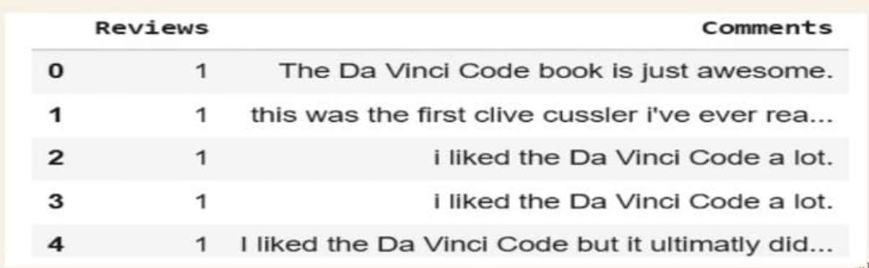
pre-processing: The following figure shows the dataset used for Movie Recommendation, which has the Reviews and Comments.

Slide 25
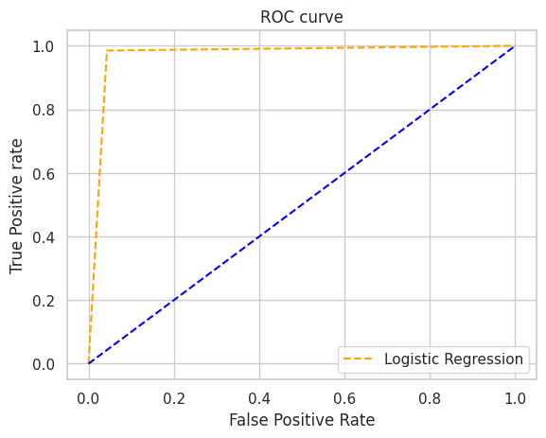
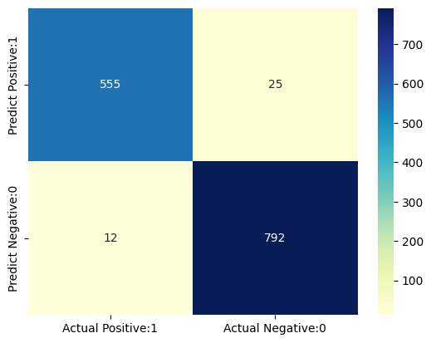
Model 1: Naïve Bayes:
• Algorithm Used: Multinomial Naive Bayes ,which is suitable for text classification problems.
• Training Approach: Grid search to find the optimal hyperparameters for the model.
• Key Metrics:
Accuracy: 0.9732658959537
F1 score: 0.97322159522204
Recall: 0.9732658959537572
Precision: 0.97335452640353

Slide 26
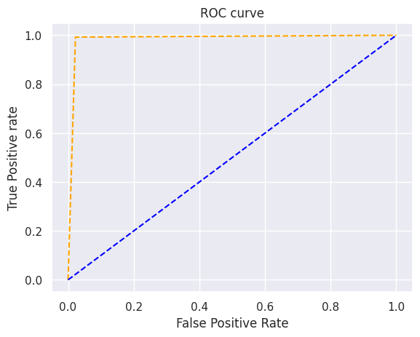
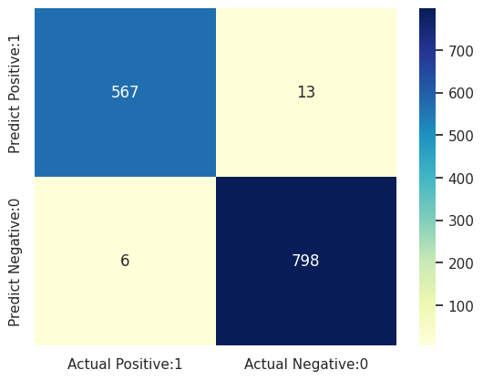
Model 2: Support Vector Classifier (SVC)
• Algorithm Used: SVC with an RBF (Radial Basis Function) kernel, which is effective in high-dimensional spaces.
• Training Approach: Grid search was used here as well to ensure the model was fine-tuned for optimal results.
• Key Metrics:
Accuracy: 0.986271676300
F1 score: 0.9862597549434
Recall: 0.986271676300578
Precision: 0.9862997895392

Slide 27
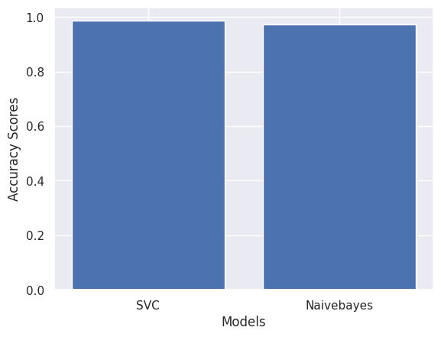
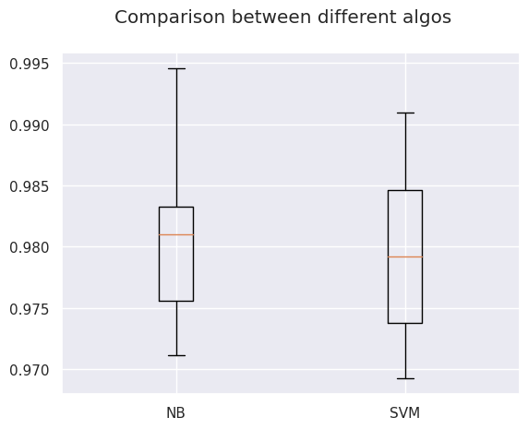
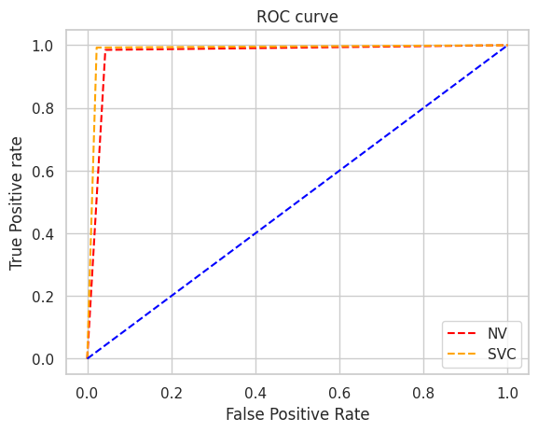
Comparison of Model Performance

Slide 28
• SVC outperformed Naive Bayes in terms of accuracy and AUC score.
• Both models have their strengths: Naive Bayes is faster to train, while SVC offers higher accuracy.
• Recommendation: SVC is a better choice for applications where higher prediction accuracy is crucial.

Slide 29
